Slide 1


NoSQL Data Management
Department of Computer Science Engineering
School of Engineering

Slide 2
Module 2 : Distributed Data Systems and Consistency Models
Distributed Data Systems and Consistency Models Distribution Models: Single Server, Sharding, Master-Slave Replication, Peer-to-Peer Replication, Combining Sharding and Replication Consistency, Update Consistency, Read Consistency, Relaxing Consistency, The CAP Theorem, Relaxing Durability, Quorums. Version Stamps, Business and System Transactions, Version Stamps on Multiple Nodes.

Slide 3
Session Summary
Topics
Distribution Models, Consistency Models
Coordination & Agreement Techniques
BASE
CAP-Theorem, Version Stamps, Transactions, Quorums
Learning Outcomes (LOs)
LO1: Explain the different distribution models (single server, sharding, replication techniques)
LO2: Differentiate between update consistency, read consistency, and relaxed consistency models, and analyze how the CAP theorem influences distributed database design.
LO3: Apply concepts of durability relaxation, quorum-based approaches, and version stamps to ensure reliability and fault tolerance in distributed data systems.
LO4: Integrate business and system transaction requirements with version stamping across multiple nodes to design scalable and consistent distributed architectures.

Slide 4
Distributed Data Systems and Consistency Models

Slide 5
Introduction
What is a Distributed System?
Distributed Data Systems – databases and storage systems that manage data across multiple servers or locations.
Modern applications (social media, e-commerce, banking) store huge amounts of data.
┌───────────────── ┐
│ User Request │
└────── ─┬─────────┘
│
┌───────────────┼────────────────┐
│ │ │
▼ ▼ ▼
┌───────────┐ ┌───────────┐ ┌───────────┐
│ Node A │ │ Node B │ │ Node C │
│ (Shard 1) │ │ (Replica) │ │ (Shard 2) │
└───────────┘ └───────────┘ └───────────┘

Slide 6
Introduction
Why distribution is needed?
Modern applications (social media, e-commerce, banking) store huge amounts of data.
Single Server can’t handle this data.
NoSQL databases (MongoDB, Cassandra, Couchbase, DynamoDB, etc.) are often distributed for scalability and fault tolerance.

Slide 7
Key Features
Data is stored in multiple machines.
Nodes communicate over a network
Users see it as one logical database
Example:
Facebook : Your profile data is stored in one server, photos in another, messages in another --- all linked together.
Why NoSQL uses distributed systems ?
Scalability – Handle billions of records by adding more machines.
Fault Tolerance – If one machine fails, others still serve data.
High Availability – Users can access data anytime, from anywhere.
Low Latency – Data stored close to where it’s used.

Slide 8
Challenges in Distributed Systems
Data Duplication – Copies of the same data exists on multiple nodes.
Network Delays – Updates take time to reach all nodes.
Conflicts – What if two users update the same record at the
same time.
CAP Theorem –
In a distributed system, you can only guarantee two of the following at the same time:
Consistency (C)
Availability (A)
Partition Tolerance (P) : The system will continue to operate and process requests even if a network failure causes a communication breakdown, or "partition," between different nodes or parts of the system.

Slide 9
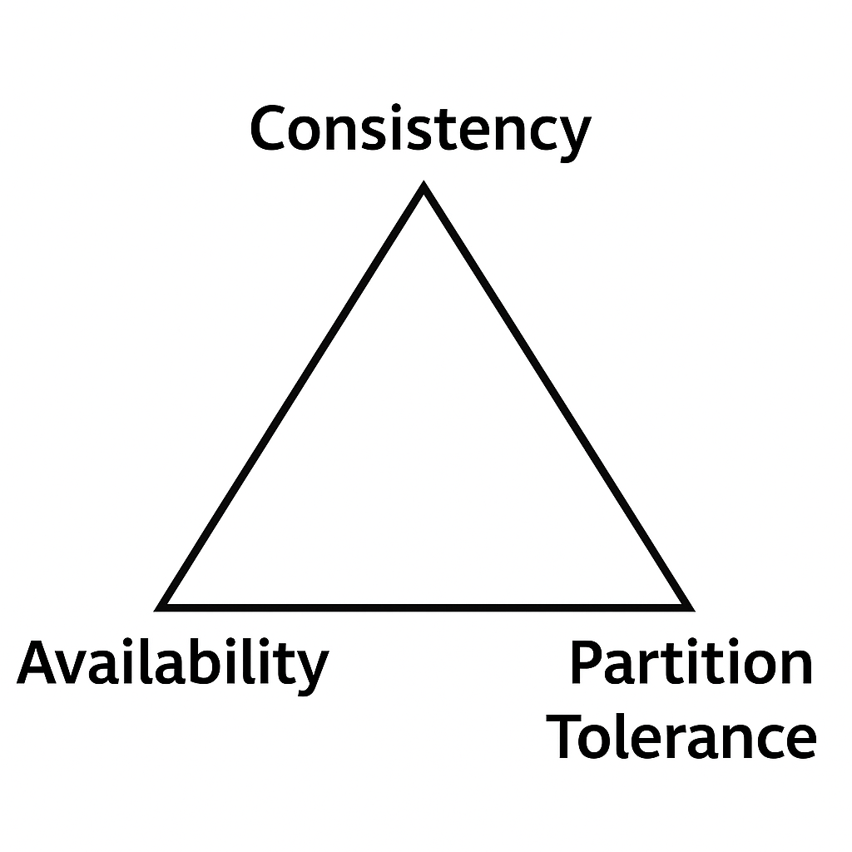
Challenges in Distributed Systems
CAP Theorem –
Consistency (C) : Every read gets the latest, correct data (same across all nodes).
After you write (update data), all nodes must agree before confirming success.
Systems prioritizing Consistency may delay responses but never show wrong balances.
Example:
You transfer ₹1000 from Account A to Account B.
Once confirmed, no matter which ATM or branch you check, your balance is updated immediately.
Systems prioritizing Consistency may delay responses but never show wrong balances.

Slide 10
Challenges in Distributed Systems
CAP Theorem –
Availability (A): Every request gets a response, even if it may not be the latest.
Each node responds with the data it has, even if it’s slightly outdated.
Fast responses, but sometimes stale or inconsistent data.
Example:
In an e-commerce site, two users try to buy the last item.
System allows both to purchase (both get a response), but inventory may show negative temporarily.
Prioritizes Availability over strict correctness.

Slide 11
Challenges in Distributed Systems
CAP Theorem –
Partition Tolerance (P): The system continues to work even if network breaks and nodes can’t communicate.
Partition: Part of a distributed System.
The cluster splits into “partitions” and each part keeps working independently.
You must choose between Consistency or Availability during the partition.
Example:
A global social network (like Facebook) with servers in India and the US.
If the link between them breaks, users in India can still post, and users in the US can still post — but they won’t see each other’s updates until the partition is fixed.

Slide 12
Challenges in Distributed Systems
CAP Theorem –
Each distributed system can choose only two guarantees:
CA → Consistency + Availability (possible only in single-node or non-partitioned systems).
CP → Consistency + Partition tolerance.
AP → Availability + Partition tolerance.

Slide 13
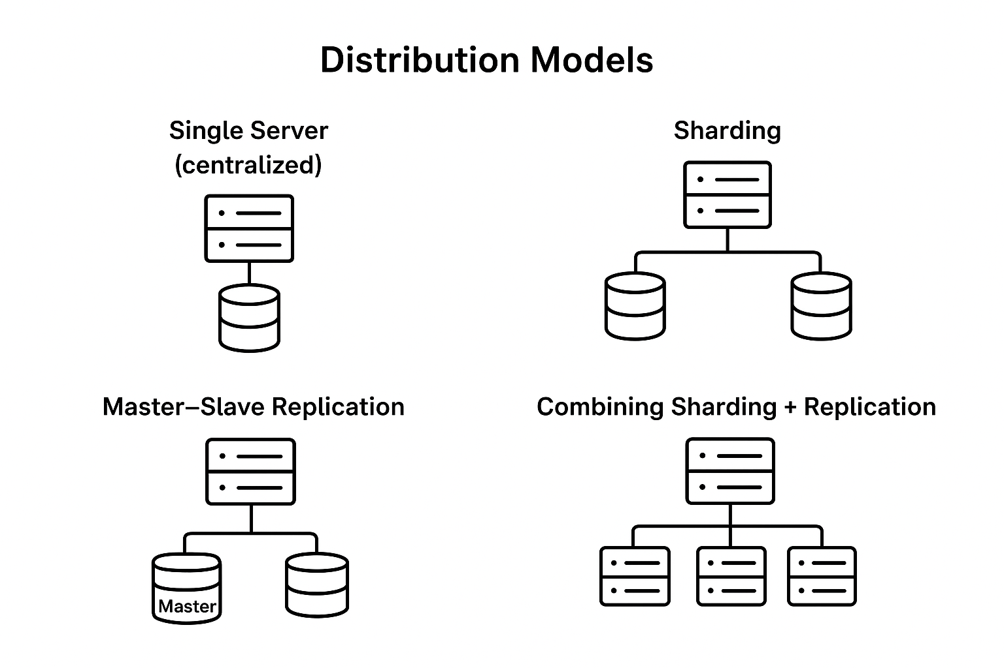
Distribution Models

Slide 14
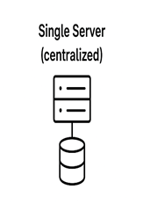
Distribution Models: Single Server (centralized):
1. Single Server (centralized):
A System where all data storage, processing, and management occur in a single machine.
Clients connect to only one server for all reads and writes.
Advantages:
Simple to design and manage.
Centralized data.
Strong consistency (only one copy of data).
Limitations:
Not scalable for large datasets or high traffic.
Single point of failure (if the server goes down, the system is unavailable).
Example: Small websites or applications with limited users.
Architecture Overview
[Client 1] \
[Client 2] > ----> [ Single Server: Data + Query Processing ]
[Client 3] /

Slide 15
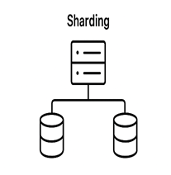
Distribution Models: Sharding (Horizontal Partitioning):
2. Sharding (Horizontal Partitioning):
The dataset is split into partitions (shards), and each shard is stored on a different server.
Advantages:
Improves scalability (data spread across multiple machines).
Balances load by distributing queries.
Limitations:
Complex to manage queries (must know which shard has the data).
Rebalancing is required if shards grow unevenly.
Example: MongoDB, Cassandra use sharding for handling massive datasets.

Slide 16
Distribution Models: Sharding (Horizontal Partitioning):
Sharding = Horizontal Partitioning of data.
Each shard contains a subset of the total data.
Each shard is stored on a different server.
Together, all shards make up the full dataset.
Horizontal partitioning means splitting rows/documents, not columns/fields.

Slide 17
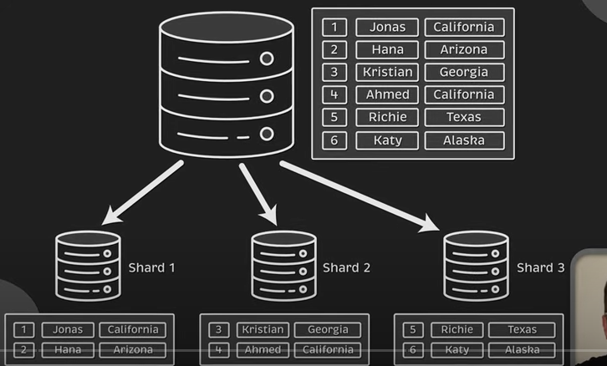
Distribution Models: Sharding (Horizontal Partitioning):

Slide 18
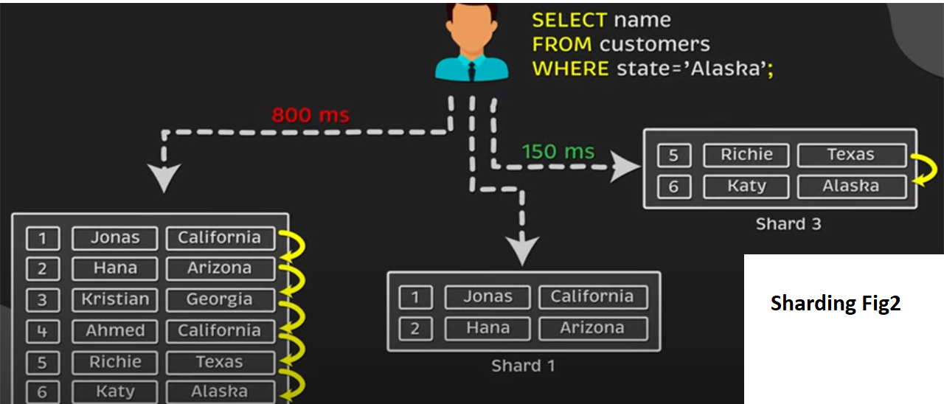
Distribution Models: Sharding (Horizontal Partitioning):

Slide 19


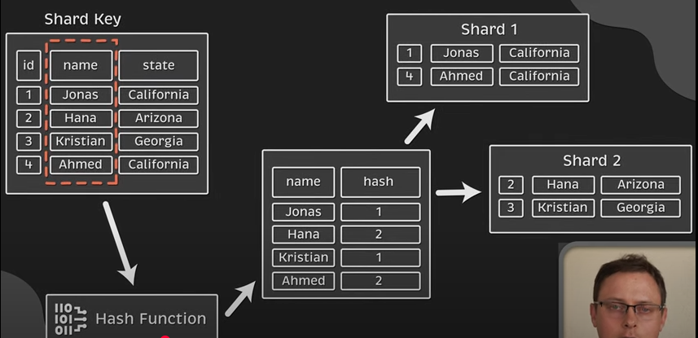


Distribution Models: Sharding (Horizontal Partitioning):

Slide 20
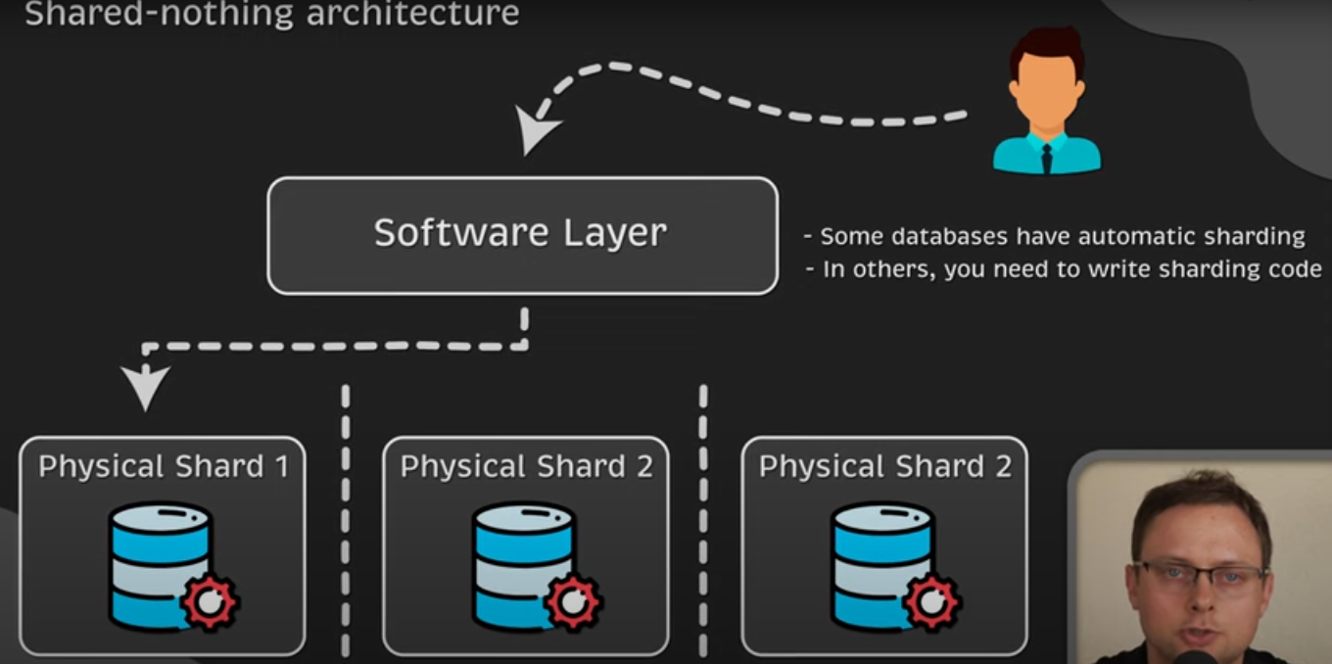

Distribution Models: Sharding (Horizontal Partitioning):

Slide 21
Distribution Models: Sharding (Horizontal Partitioning):
Purpose:
Scale out: Add more servers to handle more data/traffic.
Avoid bottlenecks: No single server does all the work.
Improve performance: Queries hit only the shard that has the data.
Handle big data: Store datasets larger than a single machine’s capacity

Slide 22
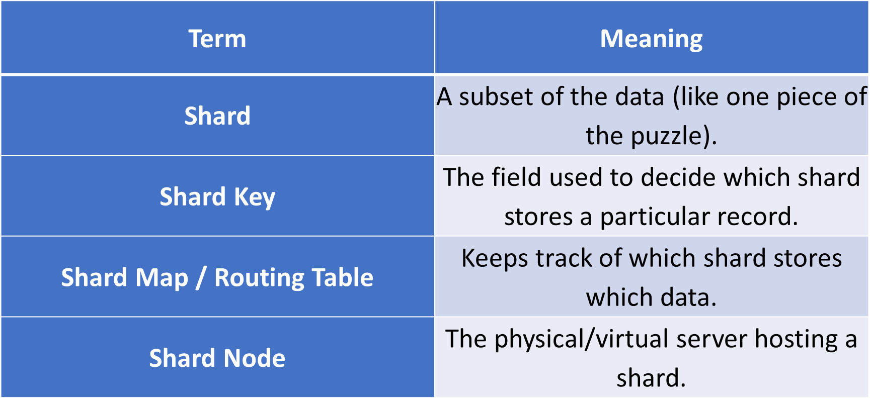
Distribution Models: Sharding (Horizontal Partitioning):
Key Concepts:

Slide 23
Distribution Models: Sharding (Horizontal Partitioning):
Sharding Strategies
1. Range-based Sharding
Data divided into continuous ranges of values.
Example:
Shard 1: IDs 1–1000 OR A-G
Shard 2: IDs 1001–2000 OR G-S
Pros: Efficient range queries.
Cons: Risk of “hot spots” if one range is accessed too much.

Slide 24
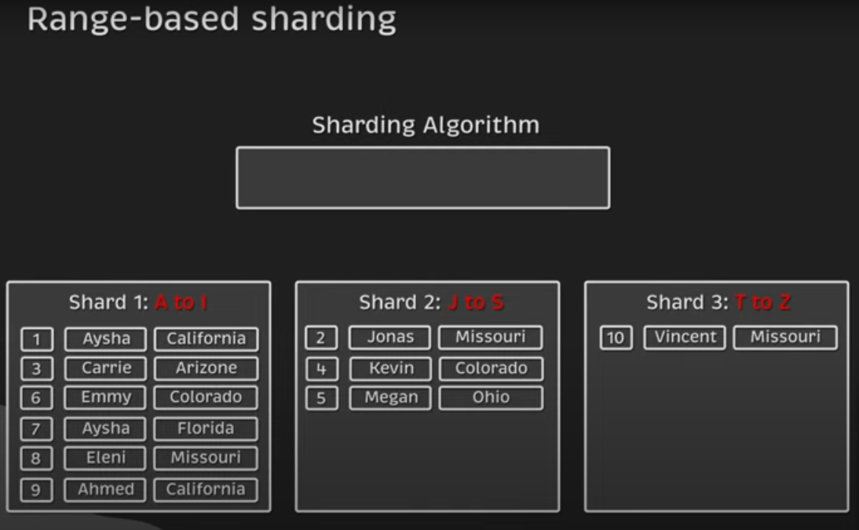
Distribution Models: Sharding (Horizontal Partitioning):
Sharding Strategies

Slide 25
Distribution Models: Sharding (Horizontal Partitioning):
Sharding Strategies
2. Hash-based Sharding
Apply a hash function to shard key → assign to shard.
Example:
hash(customer_id) % 3 → gives shard number.
Pros: Evenly distributes data.
Cons: Range queries are harder.

Slide 26
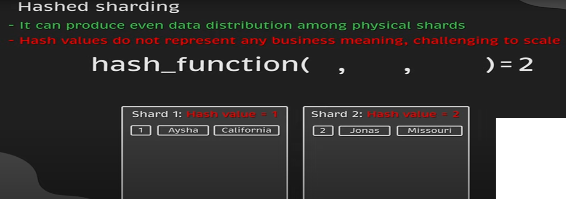
Distribution Models: Sharding (Horizontal Partitioning):
Sharding Strategies

Slide 27
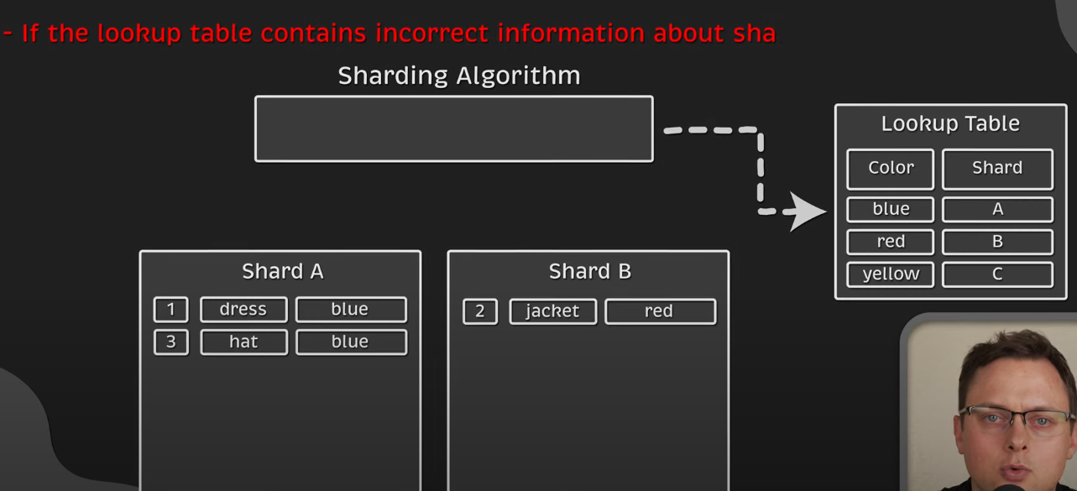
Distribution Models: Sharding (Horizontal Partitioning):
Sharding Strategies
3. DIRECTORY-based Sharding

Slide 28
Distribution Models: Sharding (Horizontal Partitioning):
Sharding Strategies
4. Geo-based or custom sharding
Partition based on location or custom business logic.
Example:
Shard 1: Asia customers
Shard 2: Europe customers
Shard 3: America customers
Pros: Localized performance optimization.
Cons: Uneven distribution possible.

Slide 29
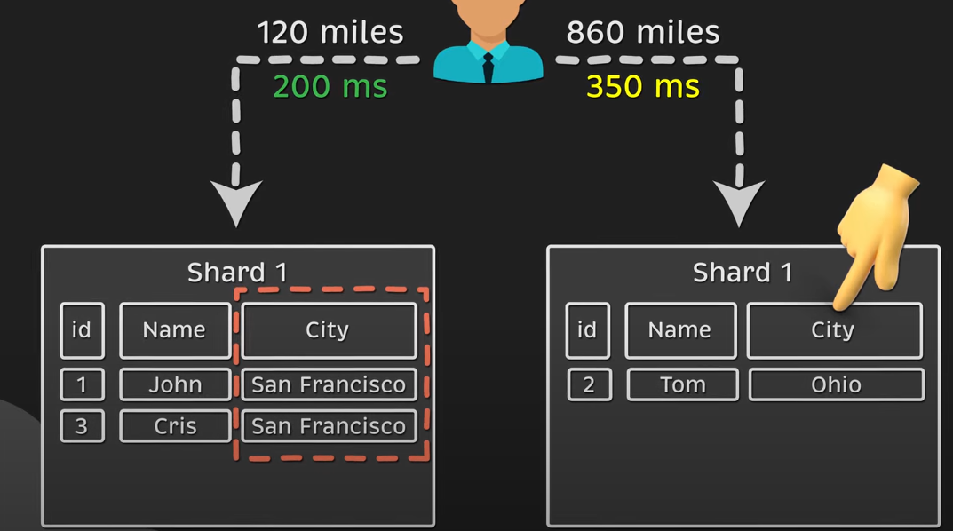
Distribution Models: Sharding (Horizontal Partitioning):
4. Geo-based or custom sharding

Slide 30
Distribution Models: Sharding (Horizontal Partitioning):
How Sharding Works?
Step-by-step:
Choose a shard key (e.g., customer_id).
Apply a sharding strategy:
Range-based (data split by value ranges)
Hash-based (data split by hash value)
Geographic/Custom (data split by custom rules)
Data is stored in the shard corresponding to the shard key’s value.
A router or query coordinator directs queries to the correct shard.

Slide 31
Distribution Models: Sharding (Horizontal Partitioning):
Sharding Advantages
Scalability – Add more shards as data grows.
Performance – Queries target only relevant shards.
Fault isolation – Failure of one shard doesn’t stop others.
Cost-effective – Use many smaller commodity servers instead of one huge machine.

Slide 32
Distribution Models: Sharding (Horizontal Partitioning):
Sharding Disadvantages
Complexity – Harder to design and maintain.
Rebalancing challenges – Moving data when adding/removing shards.
Cross-shard queries are expensive – Need to query multiple shards.
Potential for uneven load – Poor shard key choice can create hot spots.

Slide 33
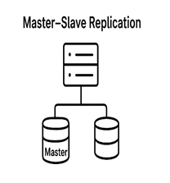
Distribution Models: Master-Slave Replication:
3. Master–Slave Replication:
One server acts as the Master (handles writes) and multiple Slaves replicate the data (handle reads).
Advantages:
Increases read performance (slaves serve read queries).
Provides redundancy and backup.
Limitations:
Master is a single point of failure.
Data is eventually consistent between master and slaves (slight delay).
Example: MySQL replication, PostgreSQL replication setups.

Slide 34
Distribution Models: Master-Slave Replication:
3. Master–Slave Replication:
In distributed data systems, especially in NoSQL databases, replication means storing multiple copies of the same data on different servers. Master-Slave Replication is one of the oldest and most widely used replication models.

Slide 35
Distribution Models: Master-Slave Replication:
3. Master–Slave Replication:
Master-Slave Replication = A replication model where:
Master node: The primary server that handles all write operations (and often reads).
Slave nodes: One or more secondary servers that receive replicated data from the master (usually read-only).
Analogy: Think of a teacher (master) who writes the original notes, and tution students (slaves) who copy them exactly into their notebooks. Students can read from their notes, but they can’t write changes back into the teacher’s notebook.

Slide 36
Distribution Models: Master-Slave Replication:
3. Master–Slave Replication:
Write operation means making changes to the database.
Examples: inserting a new record, updating an existing record, or deleting data.
In this model, only the Master node performs write operations.
Read operation means retrieving or accessing data from the database without changing it.
Examples: fetching a student’s details, generating a report, or looking up product prices.
In this model, both the Master and the Slave nodes can handle read operations, but usually, the Slaves are mainly used for reads to reduce the load on the Master.

Slide 37
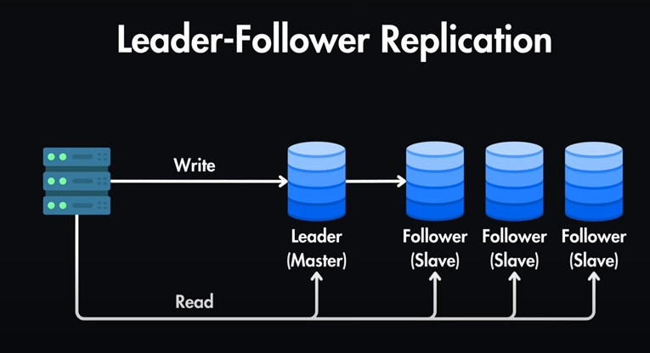
Distribution Models: Master-Slave Replication:
3. Master–Slave Replication:

Slide 38
Distribution Models: Master-Slave Replication:
3. Master–Slave Replication: How it works?
Step-by-step process:
Write operations go to the Master.
Master processes the change and logs it.
The change log is sent to all Slave nodes.
Slave nodes apply the changes to their copy of the data.
Read operations can be directed to:
Master (for the latest data).
Slaves (to distribute load).

Slide 39
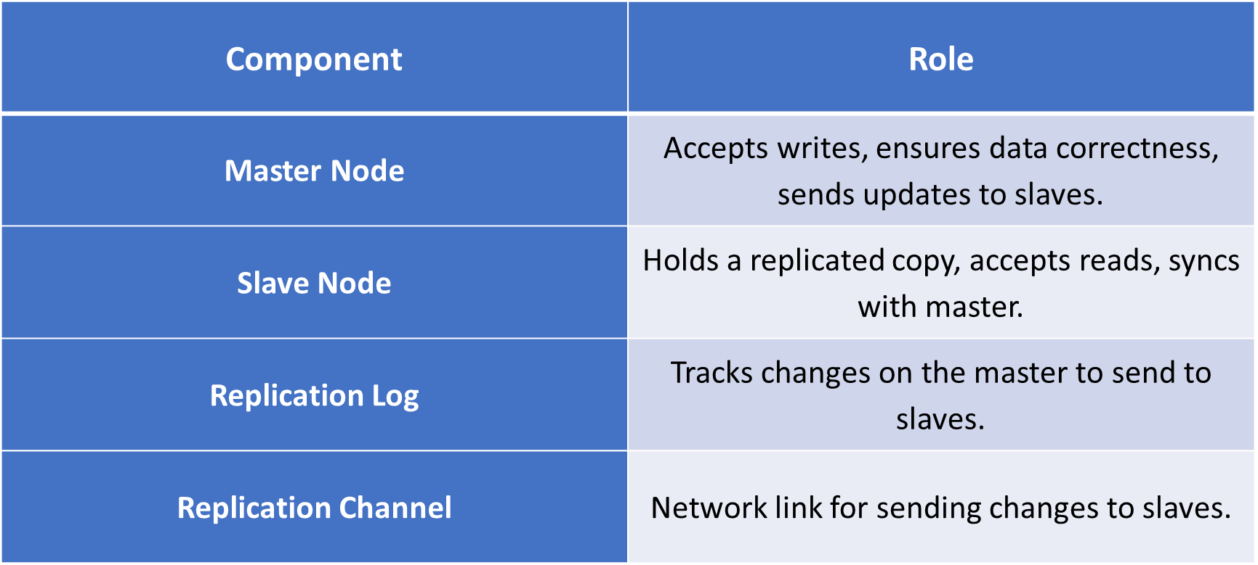
Distribution Models: Master-Slave Replication:
3. Master–Slave Replication: Key Components

Slide 40
Distribution Models: Master-Slave Replication:
3. Master–Slave Replication: Replication Types
1 Synchronous Replication
Master waits for acknowledgment from all slaves before confirming the write.
Pros: Strong consistency.
Cons: Slower writes, higher latency.
2 Asynchronous Replication
Master confirms write immediately, sends updates to slaves later.
Pros: Fast writes.
Cons: Slaves may lag behind (eventual consistency).

Slide 41
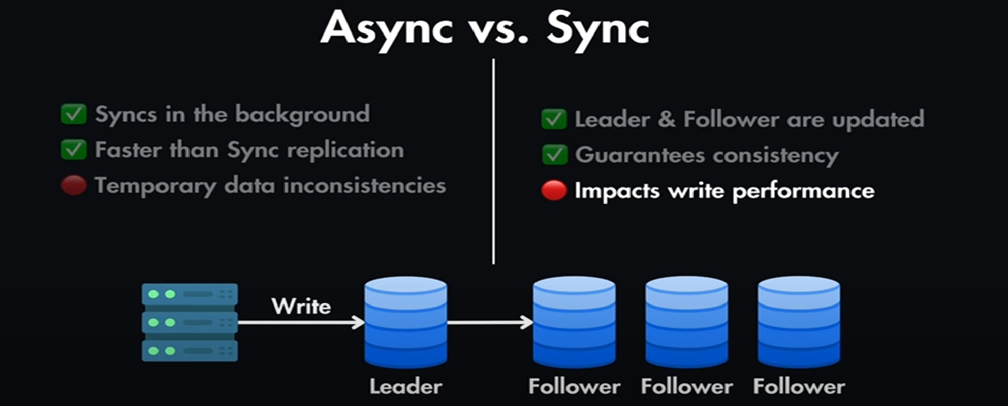
Distribution Models: Master-Slave Replication:
3. Master–Slave Replication: Replication Types

Slide 42
Distribution Models: Peer-to-Peer
4. Peer-to-Peer Replication:
Every node acts as both a reader and writer. Updates are propagated among peers.
Advantages:
No single point of failure.
Good fault tolerance and scalability.
Limitations:
Conflict resolution is complex (two peers may update the same record differently).
Example: CouchDB, DynamoDB, Cassandra (multi-master setups).

Slide 43
Distribution Models: Peer-to-Peer
4. Peer-to-Peer Replication:
In distributed systems, replication ensures high availability, fault tolerance, and scalability. Unlike Master-Slave Replication, where only one node accepts writes, Peer-to-Peer (P2P) Replication allows every node to:
Accept read requests
Accept write requests
Synchronize changes with others
Analogy: Think of a WhatsApp group where everyone can send and receive messages — there’s no “main” sender. Every member’s phone is like a peer

Slide 44
Distribution Models: Peer-to-Peer
4. Peer-to-Peer Replication:
Peer-to-Peer Replication = A replication strategy where all participating nodes are equal (peers), and any node can update data. Updates are propagated to all other peers.
3. How It Works
Step-by-step:
Any peer can accept a read or write request.
When a write occurs:
The node updates its local data.
It sends the update to all other peers.
Other peers apply the change to their copy of the data.
The system uses conflict resolution if two nodes update the same data at the same time.

Slide 45
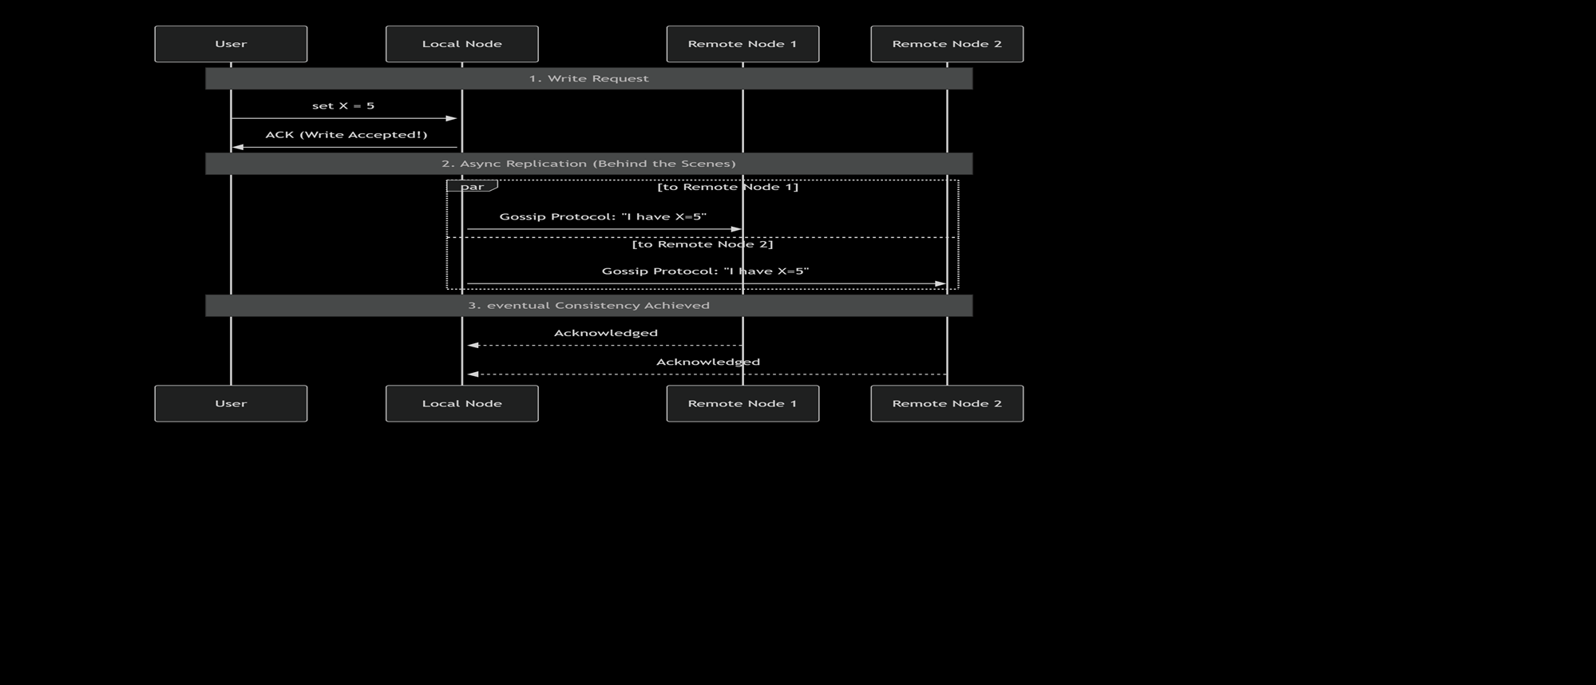
Distribution Models: Peer-to-Peer
4. Peer-to-Peer Replication:

Slide 46
Distribution Models: Peer-to-Peer
4. Peer-to-Peer Replication:
Write Request (User → Local Node)
A user/client issues a write: set x=5
The local node (the one user connects to) accepts the request.
It immediately acknowledges back to the user with ACK (Write Accepted!).
This ensures high availability (fast response).
But at this moment, only one node knows about the update.
2. Async Replication (Behind the Scenes)
The local node does asynchronous replication to other nodes (Remote Node 1 &
Remote Node 2).
It uses a gossip protocol to share the updates. Ex: Local Node tells Remote Node 1:
“I have X=5”
Then remote Node 1 passes it to others. This ensures the update gradually spreads
across the cluster.
Eventual Consistency achieved.
After some time, all nodes converge to the same value X = 5
Once Replication completes, Remote Node 1 and Remote Node 2 acknowledge that
they now have the updated value.
Eventually, the whole system becomes consistent.

Slide 47
Distribution Models: Peer-to-Peer
4. Peer-to-Peer Replication: How it works?
1.The user writes data to their closest node. The node accepts the write and immediately acknowledges it to the user, providing low latency.
2.After acknowledging, the node then takes responsibility for asynchronously propagating that change to its peers. This is often done using a gossip protocol (like how rumors spread), where nodes periodically exchange their latest data with a few random peers.
3.Eventually, all nodes receive the update and converge to the same state. This delay is the "eventual" part of eventual consistency.

Slide 48
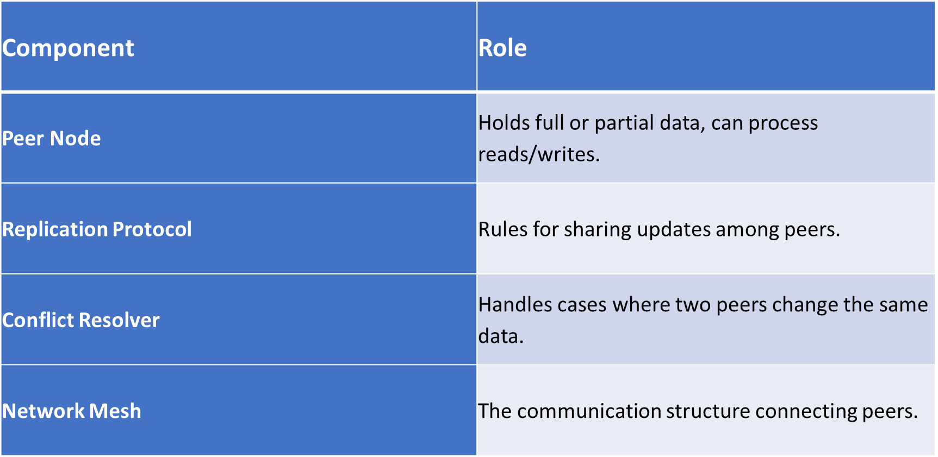
Distribution Models: Peer-to-Peer
4. Peer-to-Peer Replication: Key Components

Slide 49
Distribution Models: Peer-to-Peer
4. Peer-to-Peer Replication: Conflict Handling
In P2P replication, conflicts can occur when two peers update the same data before syncing. Common conflict resolution strategies:
Last Write Wins (LWW) – The most recent timestamp wins.
Application-defined rules – Example: In e-commerce, keep the highest inventory count.
Merge changes – Combine updates if possible.
📌 Example: Two peers update a user’s profile picture at the same time.
In LWW: The update with the later timestamp is kept.
In merge: The system might prompt the user to choose.

Slide 50
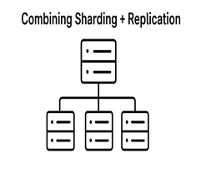
Distribution Models: Combining Sharding + Replication
5. Combining Sharding + Replication:
Each shard (partition) is replicated across multiple nodes.
Advantages:
Scalability (due to sharding).
Fault tolerance & high availability (due to replication).
Limitations:
Higher complexity in system design.
Requires sophisticated coordination between shards and replicas.
Example: Google Spanner, HBase, modern distributed SQL databases.

Slide 51
Distribution Models: Combining Sharding + Replication
5. Combining Sharding + Replication:
Modern applications generate huge amounts of data every second (e.g., Facebook posts, Amazon orders, IoT sensors). To manage this at scale, NoSQL databases use two main techniques:
Sharding → Distributes data across many machines.
Replication → Makes multiple copies of data for fault tolerance.
👉 But when both are combined, we must address consistency → how updates are kept in sync across shards and replicas.

Slide 52
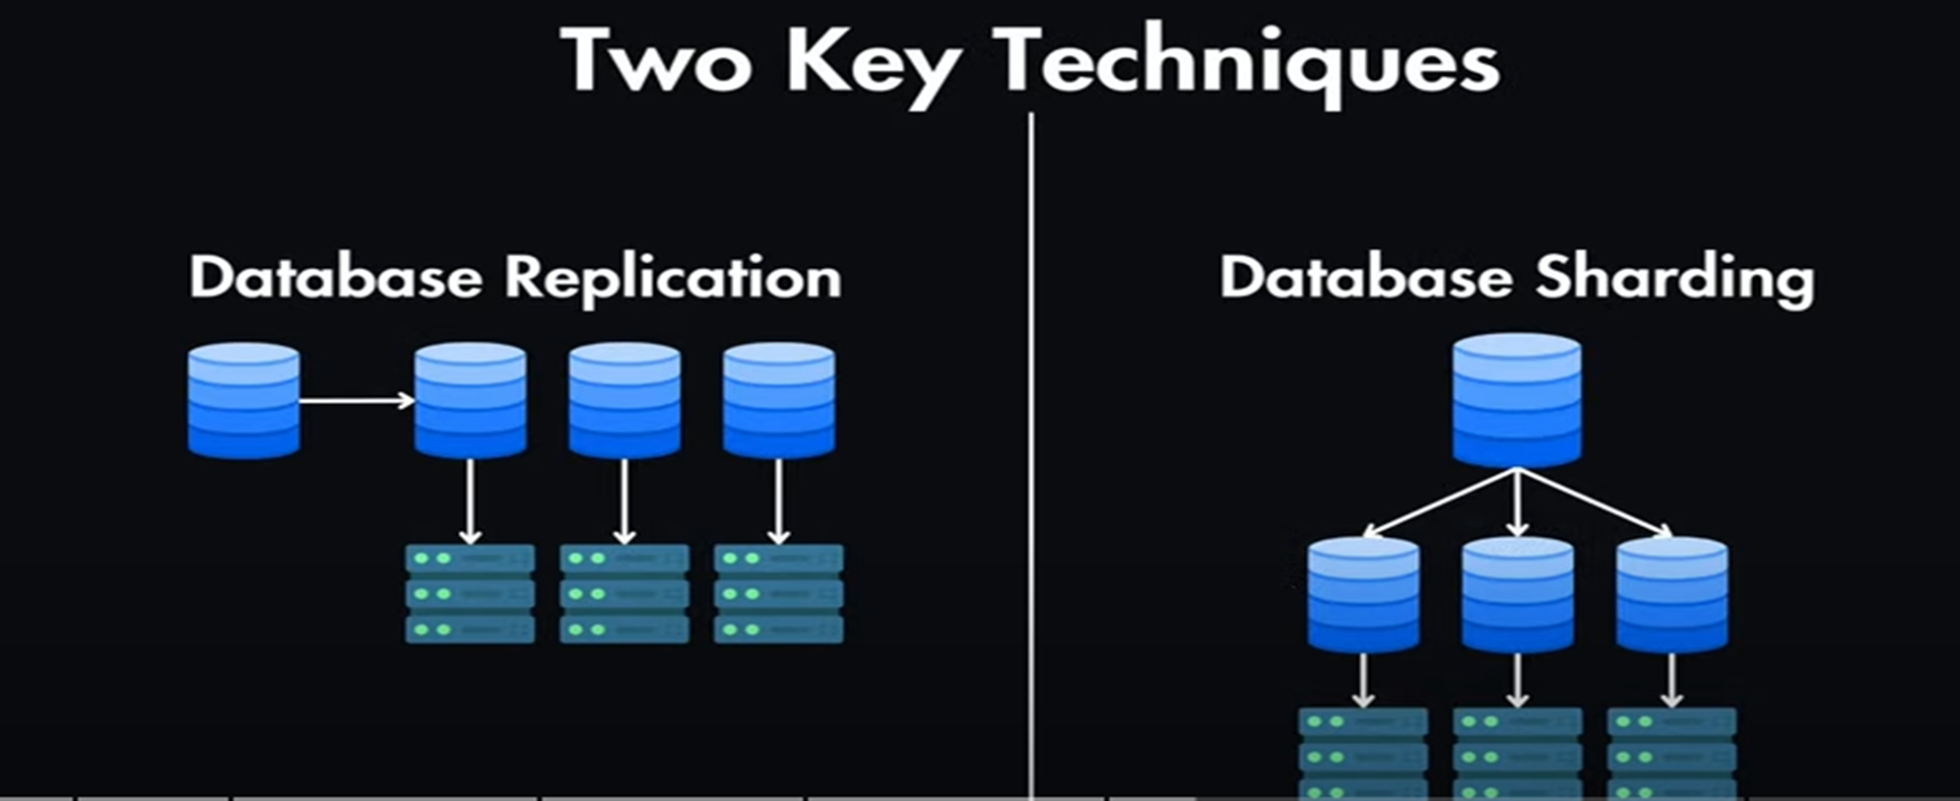
Distribution Models: Combining Sharding + Replication
5. Combining Sharding + Replication:

Slide 53
Distribution Models: Combining Sharding + Replication
5. Combining Sharding + Replication:

Slide 54
Distribution Models: Combining Sharding + Replication
Summary :
Single server → simplest, but limited.
Sharding → scales horizontally.
Replication → improves availability and fault tolerance.
Sharding + Replication → combines the best of both worlds.

Slide 55
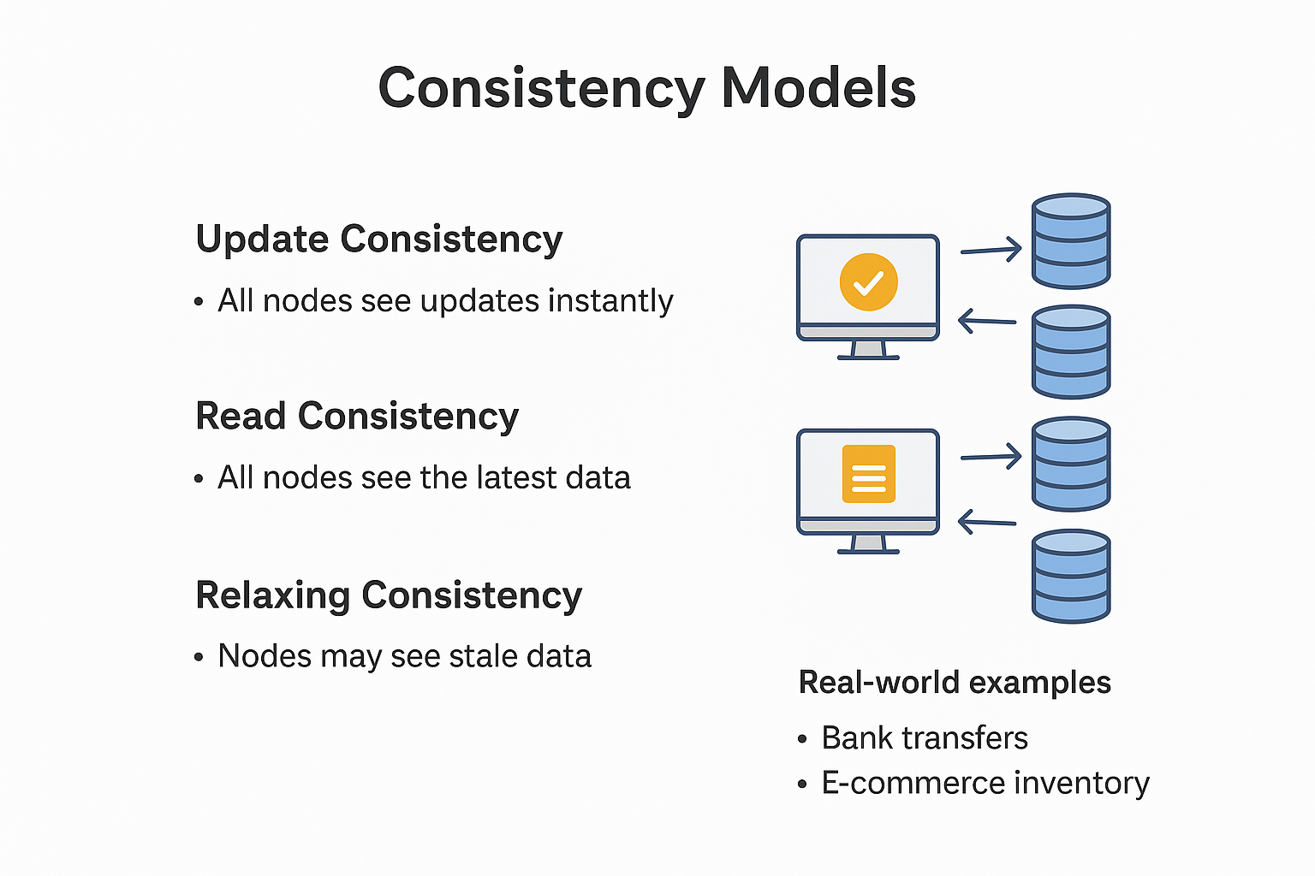
Consistency Models
Update Consistency
Read Consistency
Relaxing Consistency
Real-world examples (bank transfers, e-commerce inventory).

Slide 56
Consistency Models : Update Consistency
Update Consistency: Once a write (update) is completed, all replicas in the system eventually reflect the same final value.
Guarantee: All replicas converge to the same state after the updates.
Focus: The correctness of write operations.
Example (Bank Transfer):
You transfer ₹1000 from Account A to Account B.
Even if network delays occur, eventually both accounts will show the correct balances.
Once updates are propagated, no ATM or branch will show conflicting balances.

Slide 57
Consistency Models : Read Consistency
Read Consistency: The guarantee about what readers see after a write.
Levels:
1. Strong Consistency: Every read returns the most recent write. All replicas converge to the same state after the updates.
2. Eventual Consistency: Reads may return stale data, but eventually converge to the latest value.
3. Causal Consistency: Reads respect the cause-effect order of operations.
Example:
Last item in stock → User A buys it.
With Strong Consistency, when User B checks inventory, it immediately shows "Out of Stock".
With Eventual Consistency, User B might still see "1 item available" for a short while, even though it’s sold out.
4. Session Consistency:
A) Read-Your-Write Consistency B)Monotonic Reads C)Monotonic Writes
D) Write-follows-Reads

Slide 58
Consistency Models : Read Consistency
Read Consistency: The guarantee about what readers see after a write.
4. Session Consistency:
A) Read-Your-Write Consistency: After you write (update) data, You always see
your own data immediately.
Example: Editing your profile picture – You see new pic, even others still see old.
B) Monotonic Reads: Once you have read a value, you will never read an older
value in later reads.
Example: If you saw your bank balance as Rs.5000, the next check will never saw
other balance.
C) Monotonic Writes: If you perform multiple writes, the system ensures that they
are applied in the order you issued them.
Example: Posting a blog – Your first post “I m travelling” is saved before you edit
“I m travelling with my friends.”
D) Write-follows-Reads: If you read some data and then perform a write based on
it, the write is applied on a replica that has seen that read (or newer).
Example: You check your bank balance as Rs5000 and then transfer Rs1000 –
the transfer is guaranteed to use Rs5000 value, not an outdated one.

Slide 59
Consistency Models : Relaxing Consistency
Relaxing Consistency: Sacrificing strict consistency rules to improve performance, availability, and scalability.
Why? Because in large distributed systems, always enforcing strict consistency is costly.
Approach: Allowing temporary inconsistencies that resolve later.
Example:
Shopping Cart Service (Amazon, Flipkart):
When you add items to cart, different servers
may not synchronize immediately.
Relaxed consistency ensures that you can still
add/view items smoothly, even if updates
take a second or two to sync across regions.
Social Media Likes (Facebook/Instagram):
You may like a post, but your friend doesn’t
see your like instantly due to relaxed
consistency.

Slide 60
Consistency Models
Use Case | Preferred Consistency Model
Banking | Strong Consistency
Social Media Posts | Eventual Consistency
E-commerce Inventory | Tunable (depends on needs)
Messaging Apps | Causal / Read-Your-Writes

Slide 61
Consistency Models
Real-World Example
WhatsApp message delivery:
You see the message immediately → Read-your-writes.
Your friend gets it after network delivery → Eventual consistency.
Messages maintain order in a conversation → Causal consistency

Slide 62
Consistency Models
Example
Imagine 3 data centers: India, USA, Europe.
You update your profile picture in India.
With strong consistency, USA and Europe update instantly before confirming.
With eventual consistency, they update later but allow instant response to you.

Slide 63
Consistency Models
Key Takeaways:
Distributed systems spread data across many nodes for scalability and reliability.
Consistency models define how up-to-date the data is across replicas.
NoSQL databases often trade off strong consistency for better performance.
Choosing the right consistency model depends on the application’s needs.

Slide 64
Consistency in the Single Server Model
In NoSQL terms:
Consistency Model: Strong Consistency — Every read gets the most recent write.
Why? No replication or network delays between multiple servers.
Example:
In a MongoDB single-server setup, if you update a document at 10:00:00, all reads after that return the updated value instantly.
Architecture Overview
[Client 1] \
[Client 2] > ----> [ Single Server: Data + Query Processing ]
[Client 3] /

Slide 65
Consistency in the Single Server Model
Single Server in NoSQL Context
Even though NoSQL databases are designed for distributed setups, most can run in single-server mode:
MongoDB – run with one mongod instance.
Cassandra – run with one node (good for development/testing).
Redis – store all key-value pairs in one server.
Often used for:
Development
Small-scale applications

Slide 66
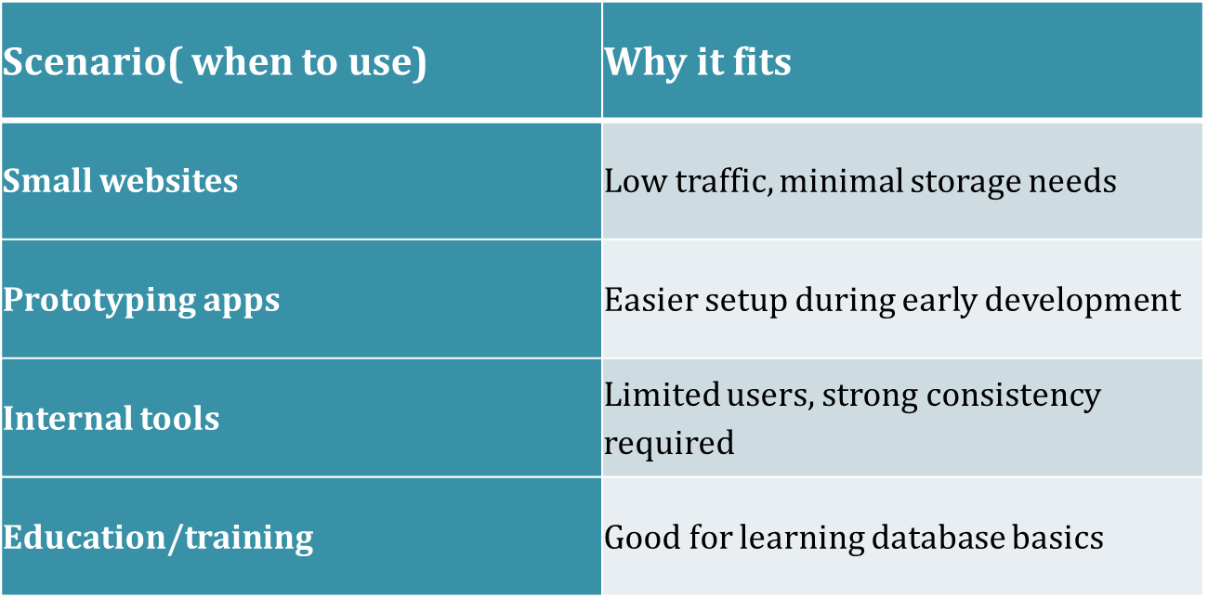
Consistency in the Single Server Model

Slide 67
Consistency in the Single Server Model
Example Use Case
Example: A small online bakery database.
Server stores:
Menu items
Orders
Customer details
Flow:
Customer places order → order stored in the database.
The baker checks the same database → sees the order instantly.
Benefit: No complex sync issues.
Risk: If server crashes during peak orders → service unavailable

Slide 68
Consistency in the Single Server Model
Applications
Small Business Inventory Systems – Track stock from one location.
School Databases – Student records stored centrally.
Local Library Systems – Catalog stored in one computer.
Personal Finance Tracker – Running on one local database.

Slide 69
Summary Table
Aspect | Single Server
Complexity | Low
Consistency | Strong
Scalability | Limited
Fault Tolerance | None
Best for | Small-scale apps, prototyping

Slide 70
Consistency in the Sharding
Consistency depends on replication inside each shard.
In NoSQL:
Each shard may be replicated for fault tolerance.
Sharding + replication is common: Sharded Cluster with Replica Sets (MongoDB).
Consistency trade-offs:
Writes to one shard do not affect others directly.
Distributed transactions across shards are harder.

Slide 71
Real-world NoSQL Sharding Examples
MONGODB – Shards collections using a choosen shard key.
CASSANDRA – Uses consistent hashing for automatic sharding.
HBase – Uses region servers for sharding.
Elasticsearch – Index split into shards for distributed search.

Slide 72
Example Scenario
Example: An e-commerce platform with millions of users.
Shard key: user_id
Strategy: Hash-based sharding
Shards:
Shard 1: Users whose hash(user_id) % 3 = 0
Shard 2: Users whose hash(user_id) % 3 = 1
Shard 3: Users whose hash(user_id) % 3 = 2
Result:
All three shards handle equal load.
Queries for one user hit only one shard.

Slide 73
Applications of Sharding
Social Media Platforms – Distribute user profiles across multiple servers.
Online Gaming – Store game states for millions of players across shards.
IoT Data Storage – Store sensor readings in different shards by device ID.
E-commerce – Orders distributed across shards by region or customer ID.
Search Engines – Split index into shards for faster search.

Slide 74
Diagram
+----------------+
Clients -->| Query Router |
+-------+--------+
|
-------------------------
| | |
+----+----+ +----+----+ +----+----+
| Shard 1 | | Shard 2 | | Shard 3 |
+---------+ +---------+ +---------+
ID 1–1000 ID 1001–2000 ID 2001–3000

Slide 75
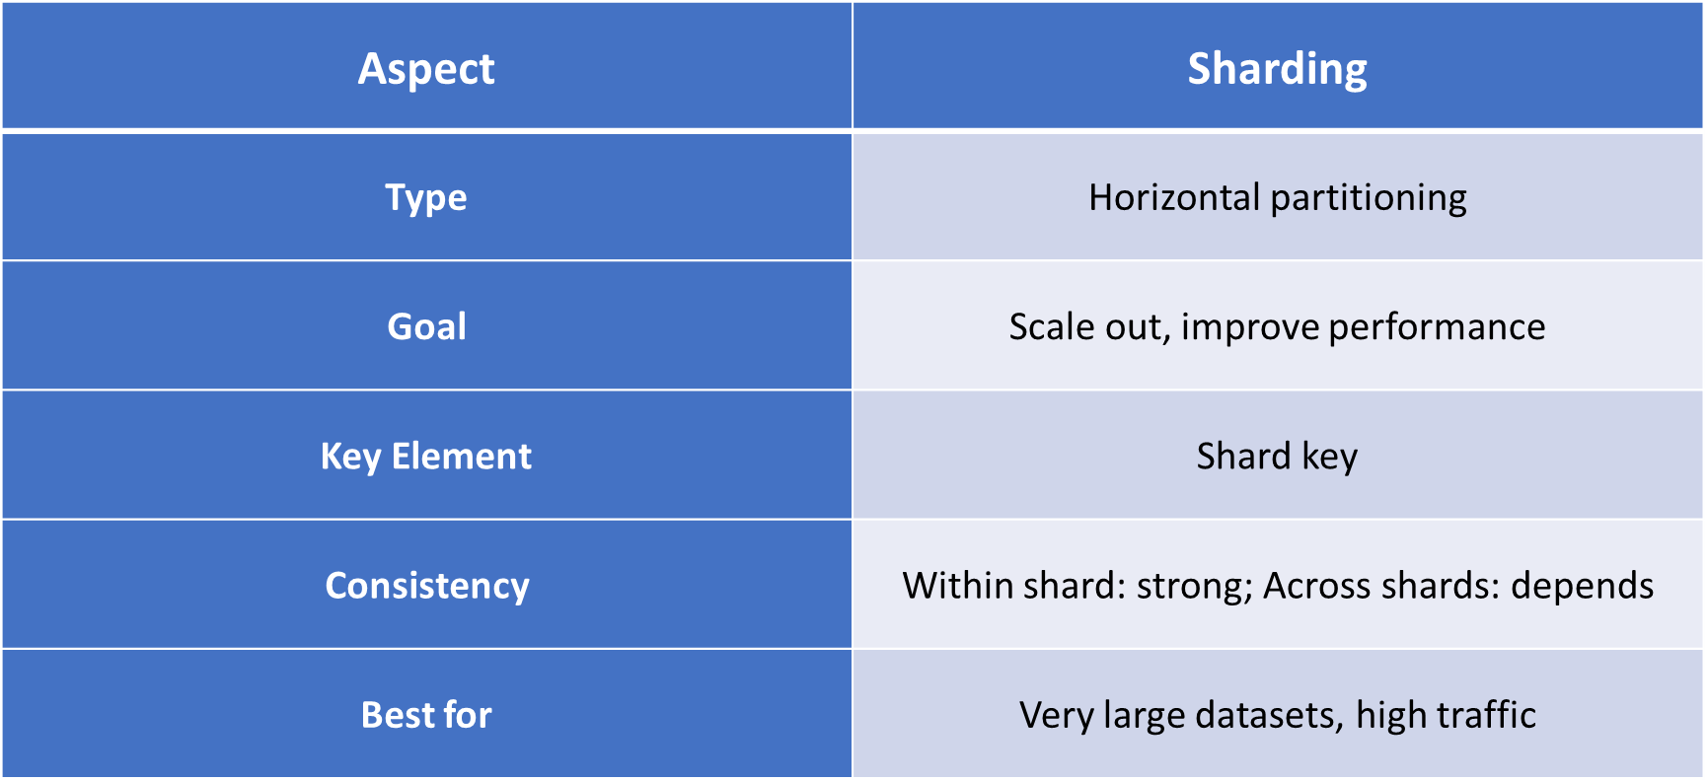
Summary

Slide 76
Consistency in the Master-Slave Replication
Strong Consistency: Achievable with synchronous replication.
Eventual Consistency: Common in asynchronous replication (slaves catch up later).
Read-After-Write Consistency: Guaranteed only if reading from master.

Slide 77
Consistency in the Master-Slave Replication
Advantages
Read Scalability – Multiple slaves can serve reads.
High Availability – If master fails, a slave can be promoted to master.
Data Backup – Slaves act as live backups.
Load Balancing – Distributes read load.
Disadvantages
Write Bottleneck – Only one master handles writes.
Replication Lag – Slaves may have outdated data (in async mode).
Failover Complexity – Promoting a slave to master can be tricky.
Single Point of Failure – If master fails before replication, data loss can occur.

Slide 78
NoSQL Examples
MONGODB – Replica sets can be configured in a primary-secondary (master-slave) pattern.
REDIS – Supports master-slave replication for read scaling.
CASSANDRA – Although more peer-to-peer. It can simulate master-slave roles in certain configurations.

Slide 79
Examples Scenario
Scenario: A social media app with millions of users.
Master handles all posts, likes, and comments writes.
Slaves handle profile searches, feed loading, and viewing comments (reads).
If traffic spikes, more slave nodes can be added to handle reads without affecting the master.

Slide 80
Real-world Applications
E-commerce websites – Product updates handled by master, product searches handled by slaves.
Social networks – Posting a new update (master), reading feeds (slaves).
Online gaming – Master stores player state updates, slaves handle leaderboard reads.
Content delivery platforms – Master stores uploaded files metadata, slaves serve read requests.

Slide 81
Simple Diagram
Writes
Client ------------------> Master
Reads \
\-------> Slave 1
\------> Slave 2
\-----> Slave 3

Slide 82
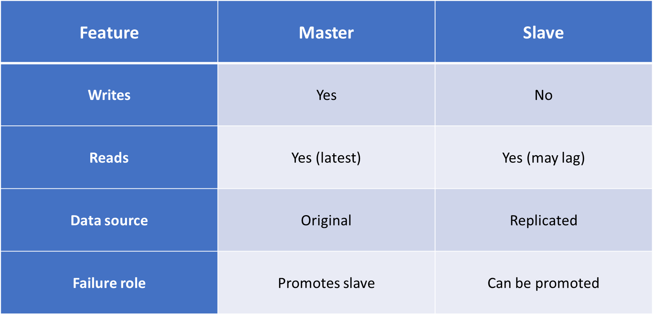
Summary

Slide 83
Consistency in Peer-to-peer Model
Eventual Consistency: Most common; updates propagate gradually until all peers have the same data.
Strong Consistency: Possible but complex — requires coordination and locking.
Causal Consistency: Updates that are related are seen in the correct order across peers.

Slide 84
Consistency in Peer-to-peer Model
Advantages:
No single point of failure – All nodes can handle writes.
High availability – Even if several nodes go down, others can continue.
Write scalability – Multiple writes can happen at the same time in different locations.
Geographical distribution – Ideal for apps with global users.

Slide 85
Consistency in Peer-to-peer Model
Disadvantages:
Conflict resolution complexity – More chances of update conflicts.
Higher network traffic – Each write must be shared with all peers.
Data convergence delay – Time needed for all peers to sync.

Slide 86
NoSQL Examples
CouchDB – Uses multi-master (peer-to-peer) replication.
Cassandra – All nodes are peers; data is partitioned and replicated.
Riak – Offers decentralized replication.

Slide 87
Examples Scenarios
Scenario: A ride-sharing app like Uber.
Multiple servers across the world (peers).
A driver in India updates their status to "Available".
That change is sent to all peers, so riders everywhere see the updated availability.
If two peers update at once (e.g., driver changes to "Busy" and another server sets "Available"), conflict resolution rules decide the final status.

Slide 88
Real-world Applications
Global social networks – Users update profiles from anywhere; data syncs globally.
Collaborative tools – Google Docs-like real-time editing from multiple users.
Content delivery – Media files uploaded in one region available in all regions.
Offline-first apps – Users work offline, and updates sync when connected.

Slide 89
Diagram
Peer A <-----> Peer B
^ \ / ^
| \ / |
v \ / v
Peer C
All peers are equal and can talk to each other directly.

Slide 90
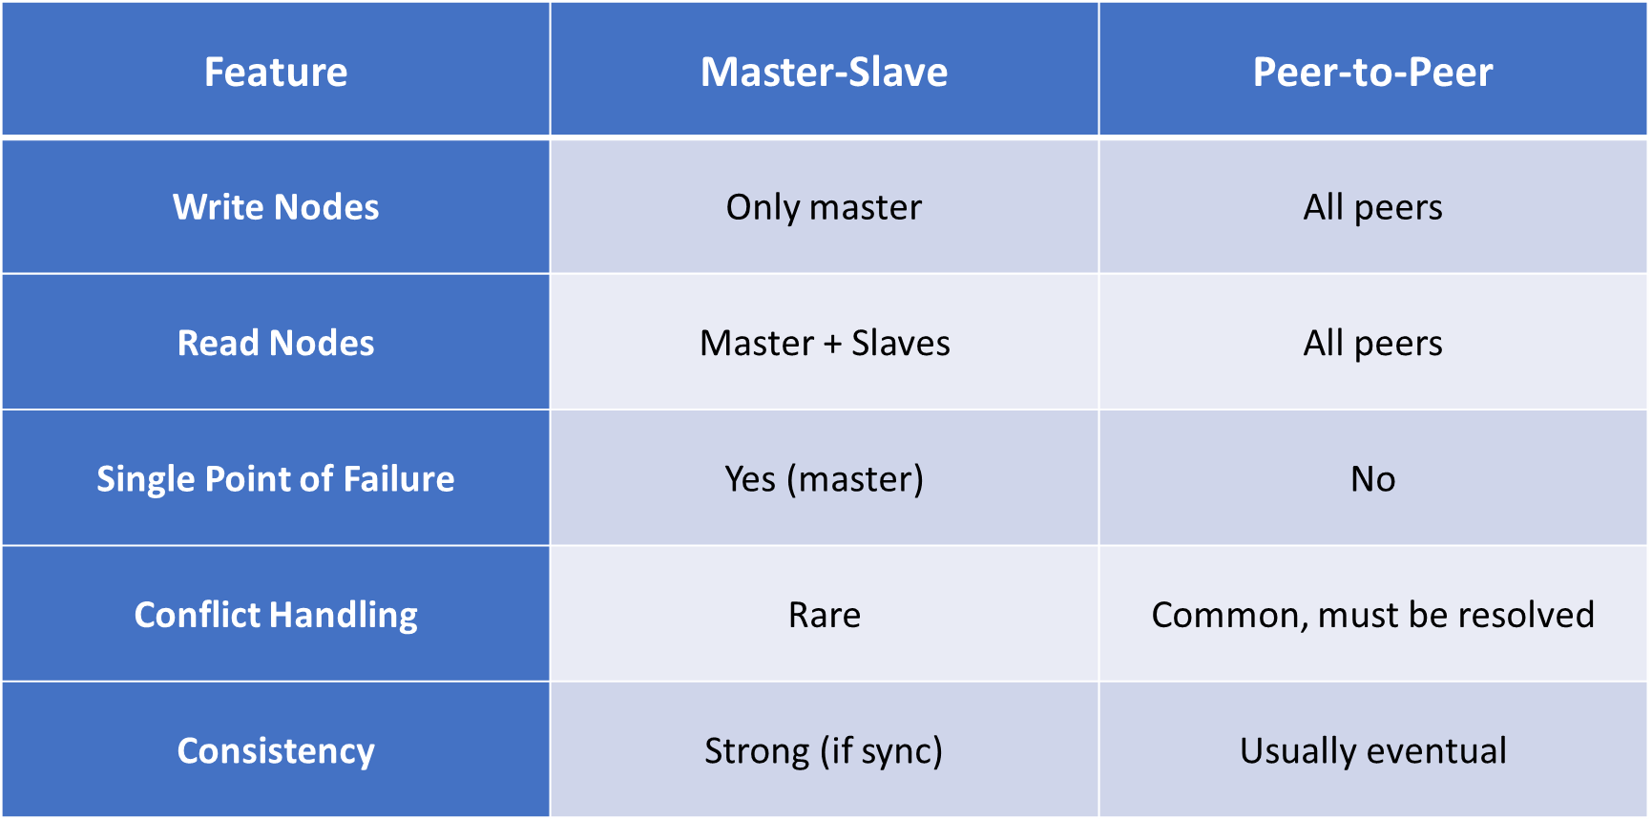
Comparison: Master-Slave vs Peer-to-Peer

Slide 91
Key Takeaway
Peer-to-Peer replication is ideal for high availability and global systems where any node can process updates. However, it requires smart conflict resolution and careful design to maintain data consistency

Slide 92
Consistency in “Sharding+Replication” Model
When sharding and replication are combined, consistency ensures that all users see correct and up-to-date data.
Types of Consistency:
Strong Consistency: All nodes see the same data immediately.
Example: Banking Transactions, Drawback: Higher latency.
2. Eventual Consistency: Updates propagate gradually, Users may see slightly stale data.
Example: Social media likes count. Drawback: Temporary inconsistency.
Casual Consistency: Related operations are in seen in order.
Example: Alice posts->Bob’s reply must come after Alice’s post.
Turnable Consistency (Cassandra, DynamoDB): Developers choose level per operation.
Balance between speed and accuracy.

Slide 93
Consistency in “Sharding+Replication” Model
Advantages in combining both:
✅ Scalable → Can handle huge datasets. ✅ Reliable → Data is not lost if servers fail. ✅ Flexible consistency → Choose strong/eventual/tunable. ✅ Better performance → Reads/writes distributed across shards and replicas.

Slide 94
Consistency in “Sharding+Replication” Model
Challenges in combining both:
Cross-shard transactions: Updating multiple shards while keeping replicas in sync is complex.
Trade-off (CAP theorem): Can’t have all 3 at once → Consistency, Availability, Partition tolerance.
Network Latency: Strong consistency requires more coordination.
Load balancing: Distributing queries evenly among shards and replicas.

Slide 95
Consistency in “Sharding+Replication” Model
Consistency Model Used:
Strong Consistency (synchronous replication): Every replica updated before acknowledging a write → slower but reliable.
Eventual Consistency (asynchronous replication): Updates propagate later → faster but may show stale data.
Quorum-Based Consistency: A read/write succeeds only after contacting a majority of replicas → balance between strong and eventual.

Slide 96
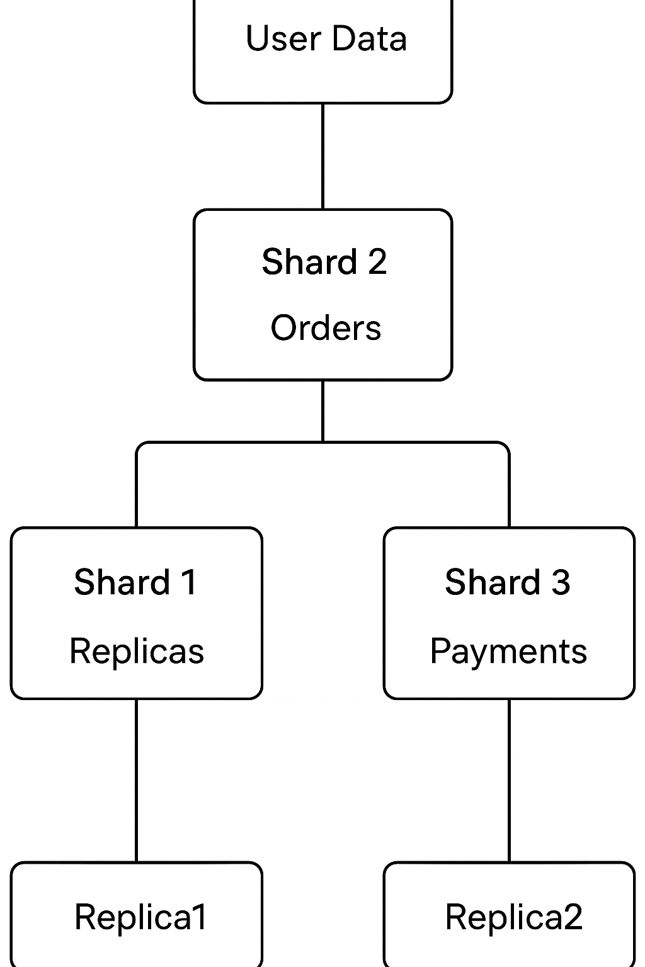
Diagram

Slide 97
NoSQL Examples
CouchDB – Uses multi-master (peer-to-peer) replication.
Cassandra – All nodes are peers; data is partitioned and replicated.
Riak – Offers decentralized replication.

Slide 98
Examples Scenarios
Banking System
Shard 1: Customer Accounts
Shard 2: Transactions
Shard 3: Loan Details
Replication ensures availability even if one node fails.
E-commerce System
Shard 1: Users
Shard 2: Orders
Shard 3: Inventory & Payments
Replication provides high read throughput for product searches.

Slide 99
Examples Scenarios
Imagine a global shopping website:
Sharding:
Asia customers → Shard A
Europe customers → Shard B
America customers → Shard C
Replication:
Each shard has 1 primary + 2 replicas.
Consistency:
Payments = Strong consistency.
Product catalog = Eventual consistency.

Slide 100
Real-world Applications
Real-World Applications of Sharding + Replication
MongoDB – Uses sharded clusters + replica sets for high scalability and fault tolerance.
Cassandra – Data partitioned (shards) and replicated across data centers with tunable consistency.
Google Spanner – Combines sharding + replication with global consistency guarantees.
Amazon DynamoDB – Provides auto-sharding and replication, offering eventual consistency and strong consistency options.

Slide 101
Summary
Sharding = Divide data for scalability.
Replication = Copy data for availability.
Consistency = Controls how updates are visible.
Combining them = Foundation of modern distributed NoSQL systems like MongoDB, Cassandra, DynamoDB.
Applications = E-commerce, social media, finance, IoT.
👉 This combination allows systems to be fast, fault-tolerant, scalable, and reliable.

Slide 102
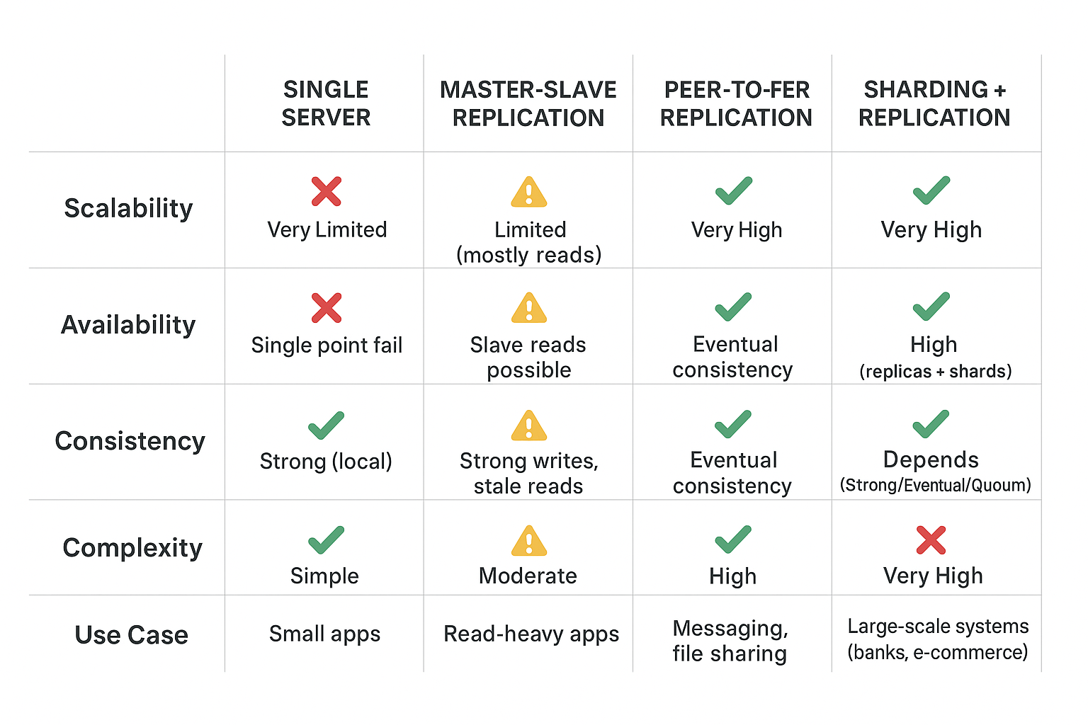
Comparison: with other models

Slide 103
Quorums
A quorum is a minimum number of votes or acknowledgments required from nodes in a distributed system to consider a read or write operation valid and successful. This mechanism helps ensure consistency and availability in the face of network partitions or node failures.
There are typically two types of quorums used in distributed systems:
Write Quorum (W): The minimum number of replicas that must acknowledge a write operation before it is considered successful. This ensures that the data is sufficiently replicated across the system to maintain consistency.
Read Quorum (R): The minimum number of replicas that must be accessed for a read operation to return a valid result. This ensures that the read operation reflects the most recent write, maintaining consistency from the user’s perspective.
The relationship between the number of nodes you need to contact for a read (R), those confirming a write (W), and the replication factor (N) can be captured in an inequality: W>N/2 , R+W>N

Slide 104
Version Stamps
Version stamps in NoSQL databases are unique values, such as timestamps, counters, or hashes, associated with a data item that change with each modification.
They are crucial for concurrency control, allowing applications to detect data conflicts by checking if the version stamp has changed since the data was last read. If the stamp has been altered, it indicates another process updated the data, prompting the application to apply a conflict resolution strategy instead of overwriting it with stale information.

Slide 105
Version Stamps
Purpose of versioning
Track Changes: Helps identify when and how a data item was modified.
Detect Conflicts: Ensures updates from different nodes are not silently overwritten.
Maintain Order: Provides a logical sequence of updates across distributed replicas.
Support Consistency Models: Enables conflict resolution strategies like last-write-
wins, merge, or application-defined policies.
Version stamps in multiple nodes
Each data item is associated with a version stamp (can be a timestamp, counter, or
vector clock).
When an update occurs:
The node increments its local version for that item.
The new version stamp is sent along with the updated data to other replicas.
Multiple nodes may generate different version stamps → useful for tracking
concurrent updates. Helps distinguish whether an update is newer, older, or
conflicting.

Slide 106
Version Stamps
Conflict resolution:
When multiple versions of the same data exist across nodes, conflicts arise.
Common strategies:
1. Last-Write-Wins (LWW):
a). The update with the latest timestamp/version replaces others.
b). Simple but may cause data loss.
c). Example: Social media status update (latest post is kept)
2. Merging:
a). Conflicting versions are combined into a single consistent state.
b). Example: Shopping cart items (union of products from different replicas)
3. Application-Defined Rules:
a). The application logic decides how to resolve conflicts.
b). Example: Banking transactions: additive merge (credit+debit), not
overwrite
4. User Intervention:
a). In rare case, system asks users to choose which version to keep.
b). Example: Document editing in Google Docs.

Slide 107
Version Stamps
Summary:
Version stamps are essential for ensuring data consistency across distributed nodes, detecting conflicts, and enabling reliable conflict resolution policy.

Slide 108

Transactions in Distributed Systems
Business Transactions (application-level)
System Transactions (database/system-level)
How transactions interact with consistency

Slide 109
Business and System Transactions
Business transactions refer to meaningful activities or interactions that occur in the context of a business operation. These transactions typically involve the exchange of goods, services, or information and have a direct impact on the organization's financials or operational processes.
Examples include sales transactions, purchase orders, inventory management, and customer interactions.
System transactions, on the other hand, refer to the operations performed by a database management system (DBMS) to ensure the integrity and consistency of data during business transactions.
These transactions are fundamental to the functioning of the database and follow the ACID (Atomicity, Consistency, Isolation, Durability) properties to guarantee reliable processing.

Slide 110
Version Stamps on Multiple Nodes
Version stamps on multiple nodes are a crucial mechanism in distributed systems, enabling the tracking and management of data versions across different replicas or nodes. This approach helps maintain consistency, resolve conflicts, and ensure data integrity in environments where concurrent updates may occur.
In a distributed system, each node maintains its own version stamp for data items, which can be either logical timestamps, vector clocks, or physical timestamps.
When a node performs an update to a data item, it associates the update with its current version stamp. This versioning allows the system to track changes and determine the most recent version of the data across all nodes.
Logical Timestamps: Each update is assigned a unique logical timestamp based on the order of operations. If two nodes perform updates concurrently, their timestamps help in determining the sequence of updates.
Conflict resolution

Slide 111
Version Stamps on Multiple Nodes
Vector Clocks: Each node maintains a vector clock that counts the number of updates it has made and tracks updates from other nodes. When a node updates a data item, it increments its own entry in the vector clock and may also compare its vector with others to resolve conflicts.
Physical Timestamps: In systems using physical timestamps, each update is time-stamped based on real-time. However, this approach can face challenges related to clock synchronization across nodes.

Slide 112


